Slide 1
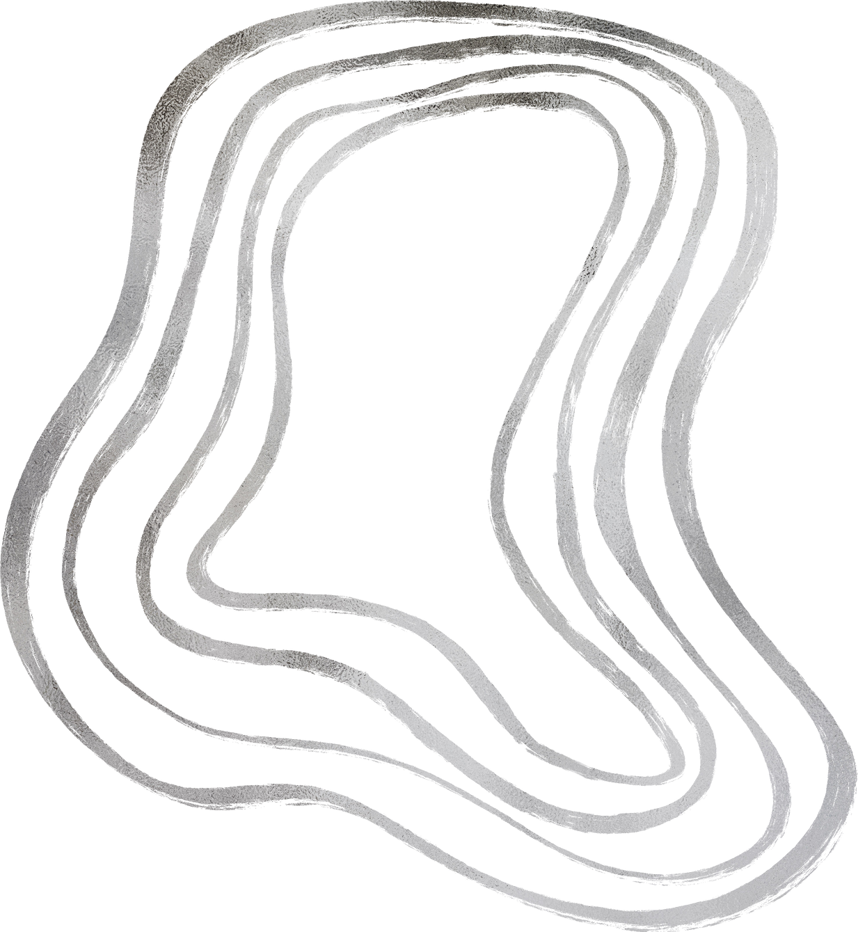


Smart Student Performance Prediction System
Alya Marwan 202200375
Nada Mohamed 202200635
Ashar Salama 202200199
Malk Osama 202200444

Slide 2






Our Bonus part
Our streamlit app
Our GitHub repository

Slide 3

Data Understanding and Exploration
The first step was to understand the underlying structure of our dataset.
We started by running descriptive statistics to get a comprehensive overview of our data. By looking at the mean and standard deviation, we were able to see the spread of the scores and identify any immediate data entry errors or extreme values that didn't make sense within the context of the project.

Slide 4
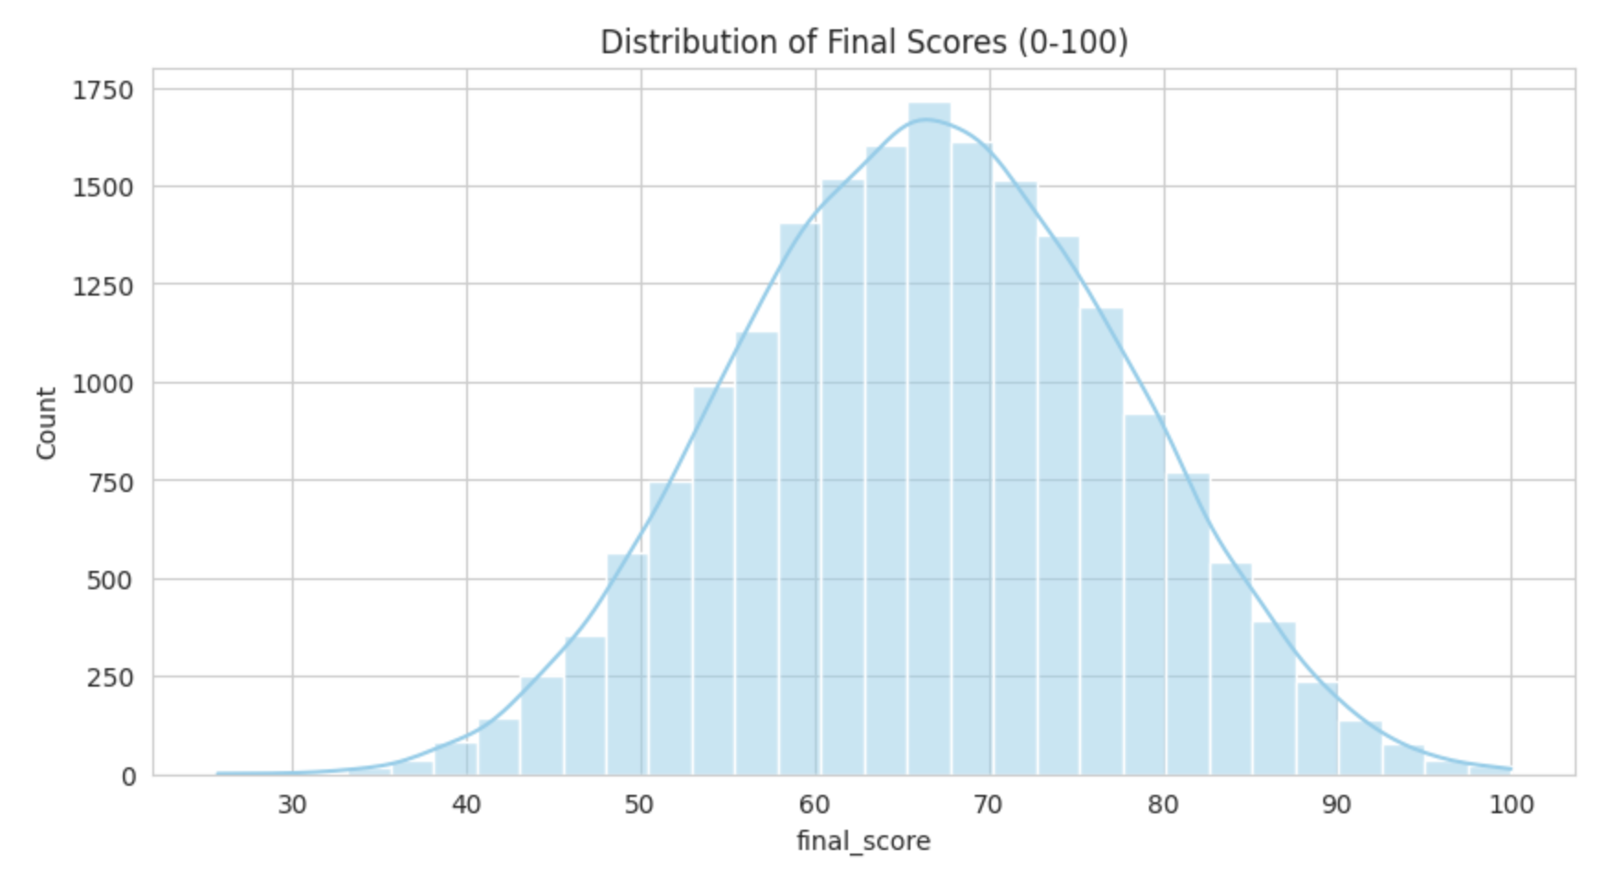
Data Understanding and Exploration
Visualizing the distribution was key. We plotted the scores to see if they followed a normal or if they were skewed. Understanding this distribution informed our later decisions on whether to use specific scaling methods or transformations to make the data more 'model-friendly'.

Slide 5
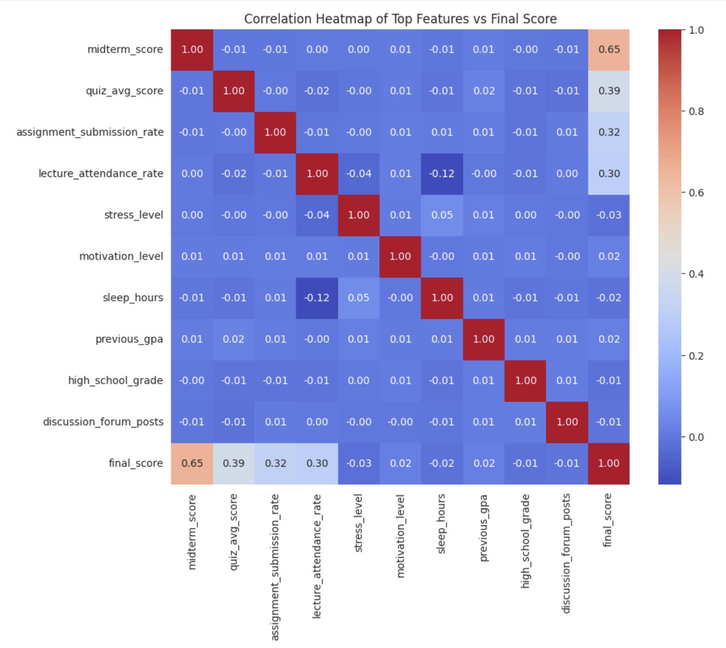
Data Understanding and Exploration
Next, we used a correlation heatmap to see how features interact. We look for features that had a strong relationship with our target score. More importantly, we checked for multi-collinearity which can confuse a model and degrade performance.

Slide 6


Data Understanding and Exploration
Identify Noisy or Irrelevant Features:
We checked the absolute correlation with the final score to identify potentially irrelevant features
Feature variance was analyzed to identify near-constant or highly dispersed features, serving as a supplementary indicator alongside correlation.
Noise often manifests as extreme values that deviate significantly from the rest of the dataset. The IQR method was applied to identify noise by focusing on the "middle 50%" of the data and flagging points that fall too far outside this central range.
Features found noisy were online_portal_usage_minutes, study_hours_last_semester, parent_income, sleep_hours, and lecture_attendance_rate.

Slide 7
Data Understanding and Exploration
Machine Learning models cannot handle missing data. We scanned the dataset for null values and applied imputation; by median for numerical features and by mode for categorical features to ensure we didn’t lose valuable rows while maintaining the overall statistical integrity of the set.

Slide 8



Data Understanding and Exploration
To ensure our model wasn't distracted by extreme anomalies, We visualized the outliers using box plots then used IQR to identify and treat outliers. By filtering out data points that fell significantly outside the expected range, we created a better dataset that more accurately reflects typical student performance. Instead of removing outliers entirely, which could reduce dataset size and introduce bias, values falling below the 1st percentile or above the 99th percentile in the training set were capped at those thresholds. This preserves the overall structure of the data while limiting the influence of extreme observations.

Slide 9



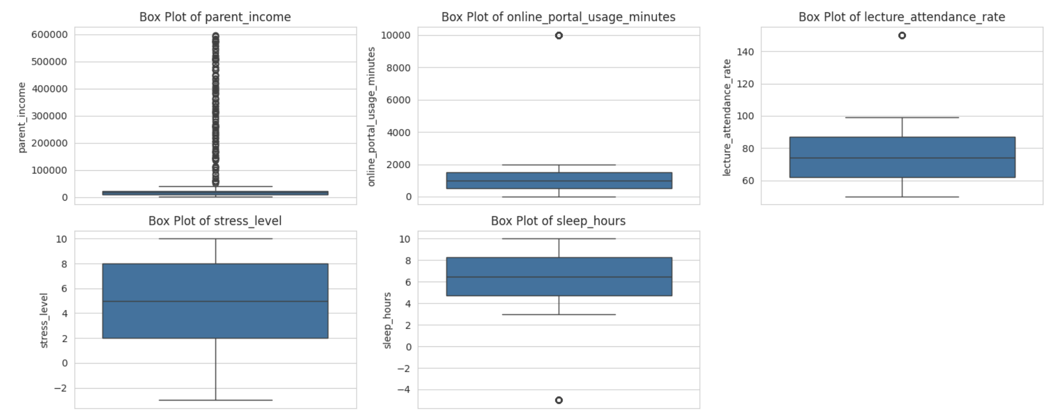
Data Understanding and Exploration

Slide 10
Data Understanding and Exploration
Since mathematical models only understand numbers, we encoded our categorical features. Using One-Hot Encoding, this technique creates binary columns for each category, ensuring that no ordinal relationship is incorrectly imposed on non-ordinal data.

Slide 11


Data Understanding and Exploration
Feature scaling was applied to ensure that numerical features contribute equally to model training, preventing features with larger ranges from dominating the learning process. Using StandardScaler, each numerical feature is transformed to have a mean of 0 and a standard deviation of 1, based solely on the training data's distribution.

Slide 12

Data Understanding and Exploration
We split the data into three sets. The models learns on the Training set, we fine-tune it on the Validation set, and finally, we test its true performance on the the Test set. This structured approach ensures our models are trained on sufficient data while retaining separate subsets for hyperparameter tuning and final unbiased evaluation.

Slide 13
Data Understanding and Exploration
Lastly, we addressed class imbalance. If one outcome is much more frequent than others, the model becomes biased. We used SMOTE to synthetically create new examples of the minority class by interpolating between existing examples, ensuring the model is equally skilled at predicting all possible outcomes. By applying SMOTE only to the training set and keeping the validation and test sets in their original, imbalanced state we simulate a realistic evaluation scenario and ensure our model's performance metrics reflect real-world applicability.

Slide 14
Model Training
With the data fully prepared, we moved to model training. Our strategy was to test a spectrum of algorithms to find the best predictor of student outcomes. We used Linear Regression as a simple, interpretable baseline for final score prediction. To capture more complex patterns, we implemented SVM, XGBoost, Random Forest, and Decision Trees. This approach allowed us to compare linear, tree-based, and ensemble methods side-by-side to see which best learned from the student data we explored.

Slide 15


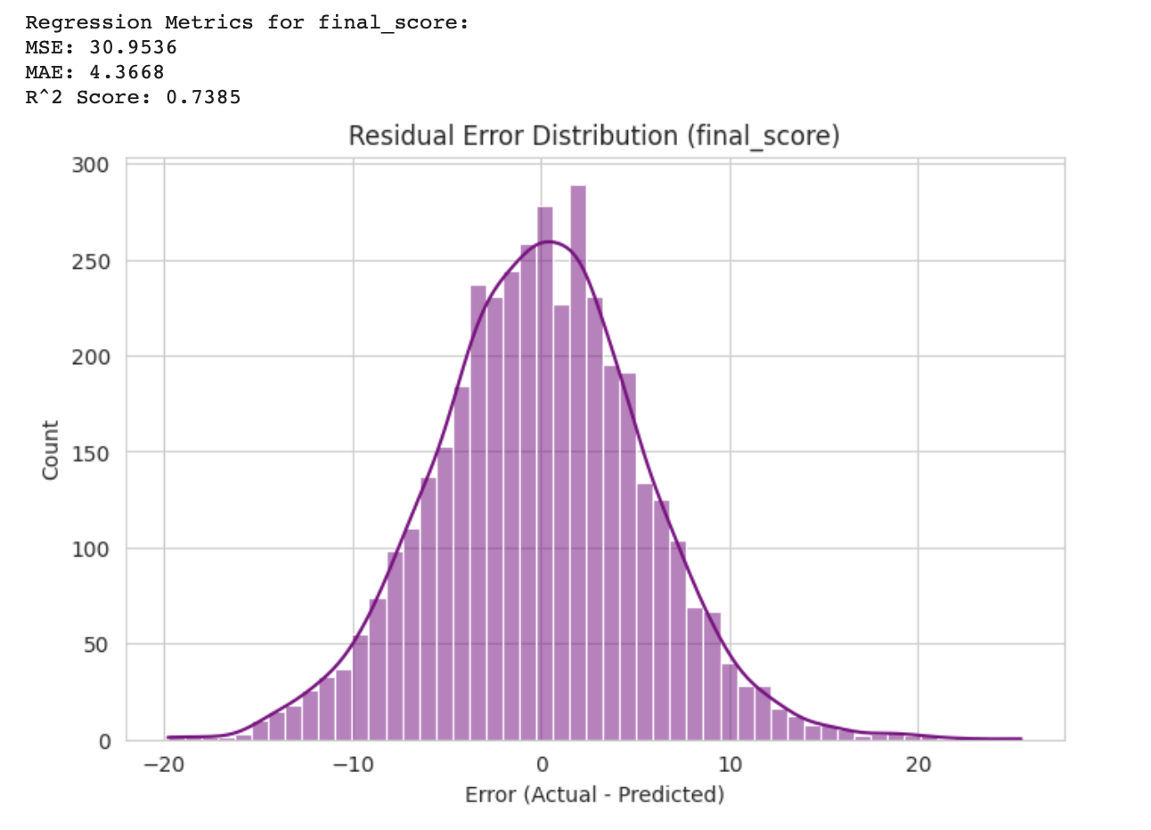

XGBoost for final_score

Slide 16
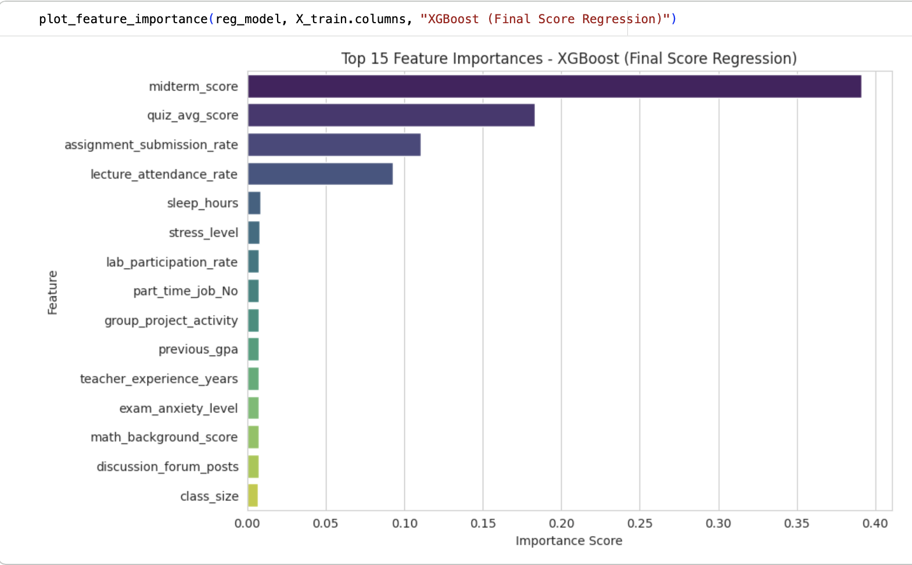
XGBoost for final_score

Slide 17
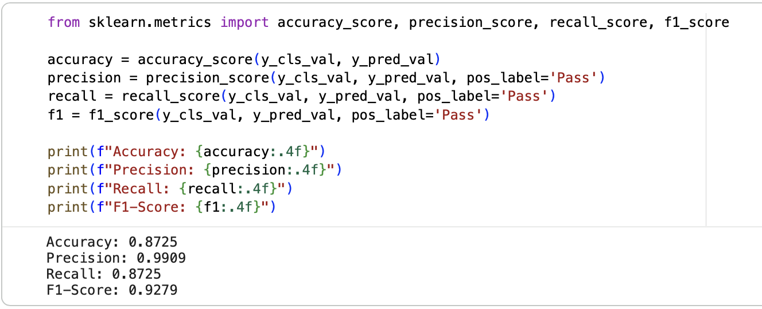
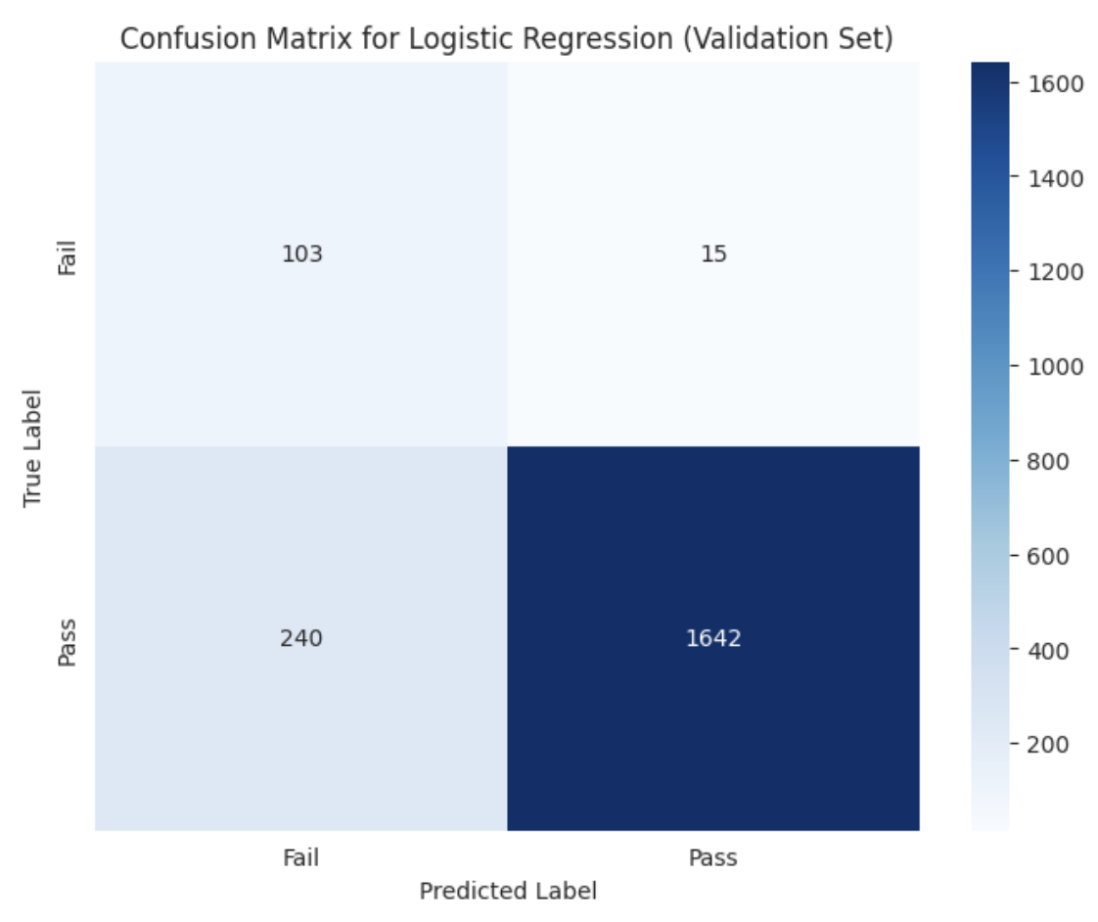
Binary Logistic Regression for pass_fail

Slide 18
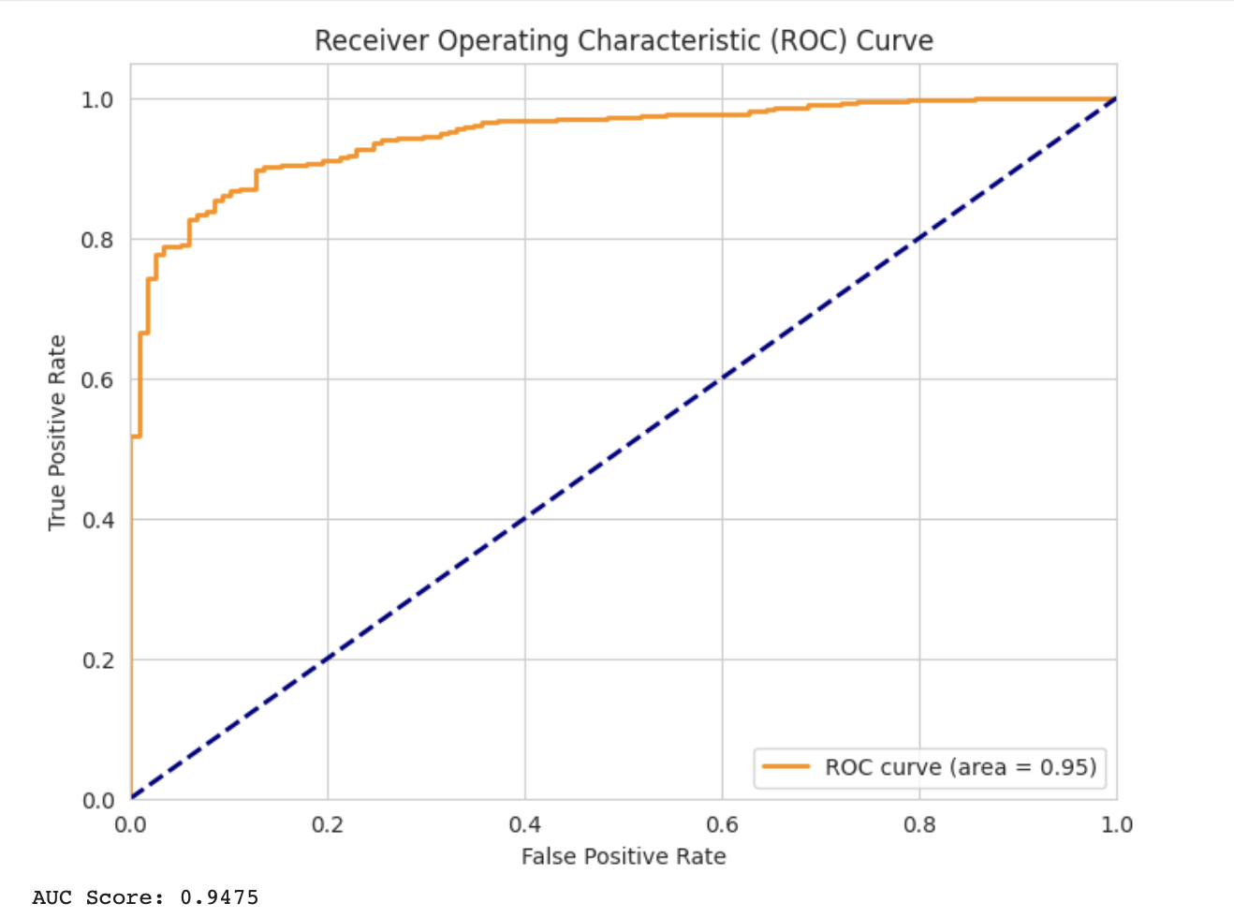
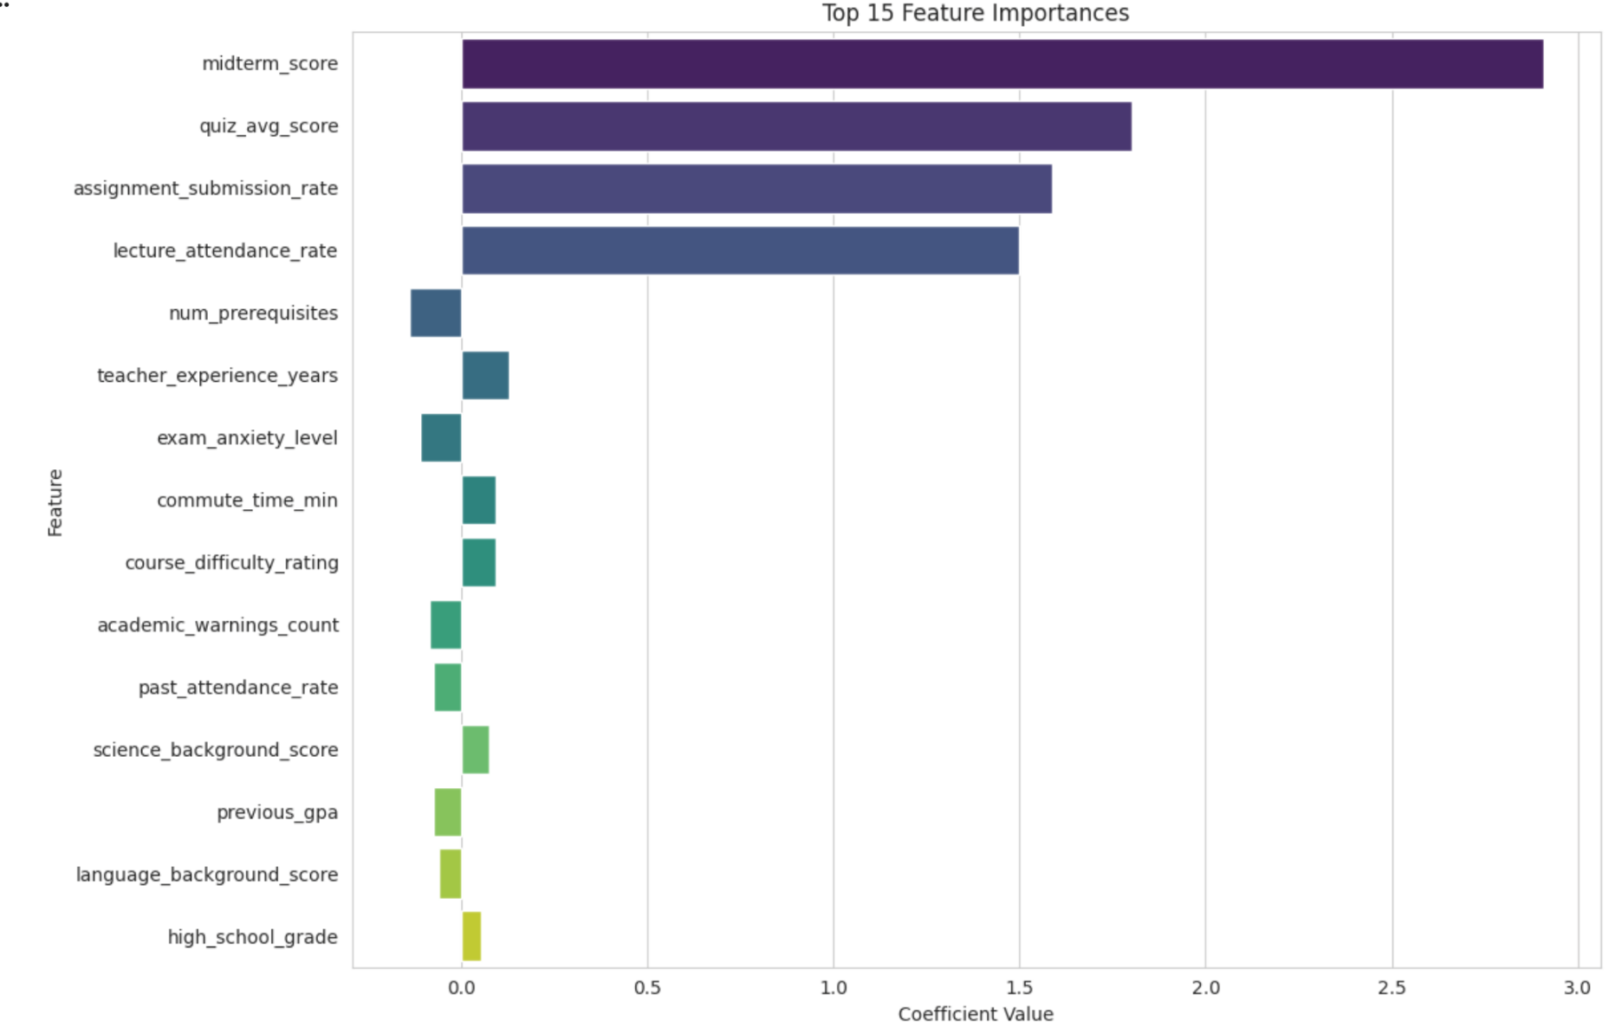
Binary Logistic Regression for pass_fail

Slide 19
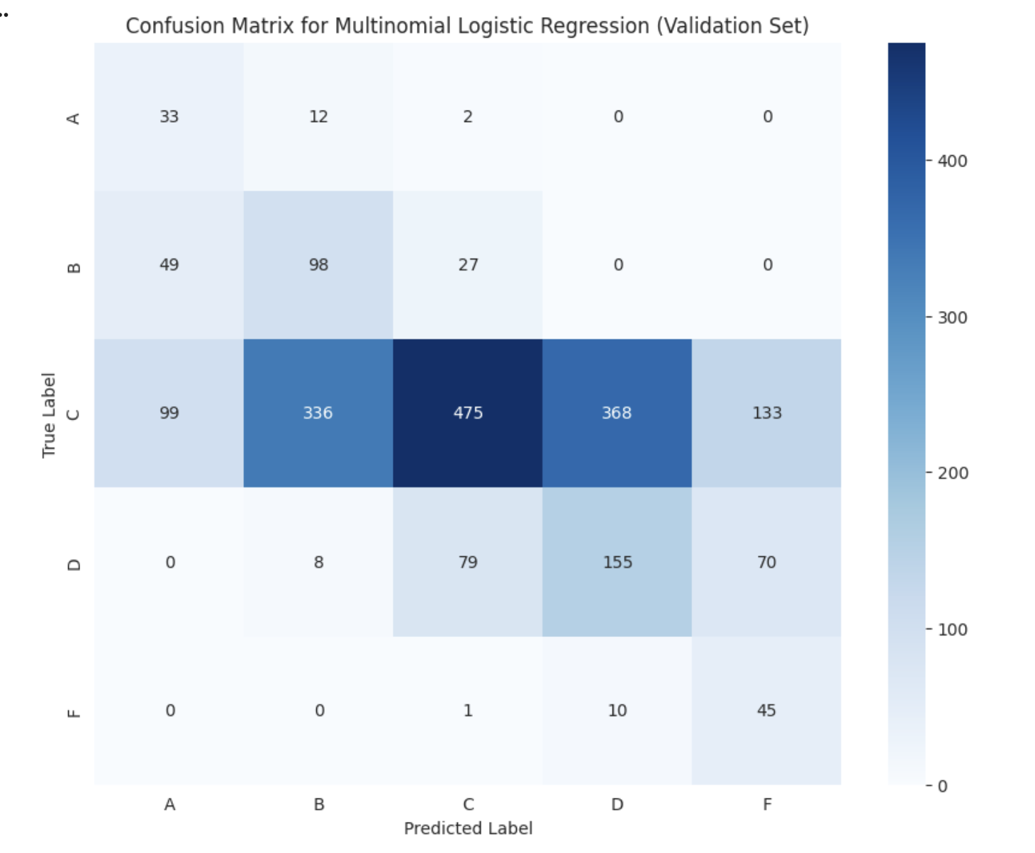
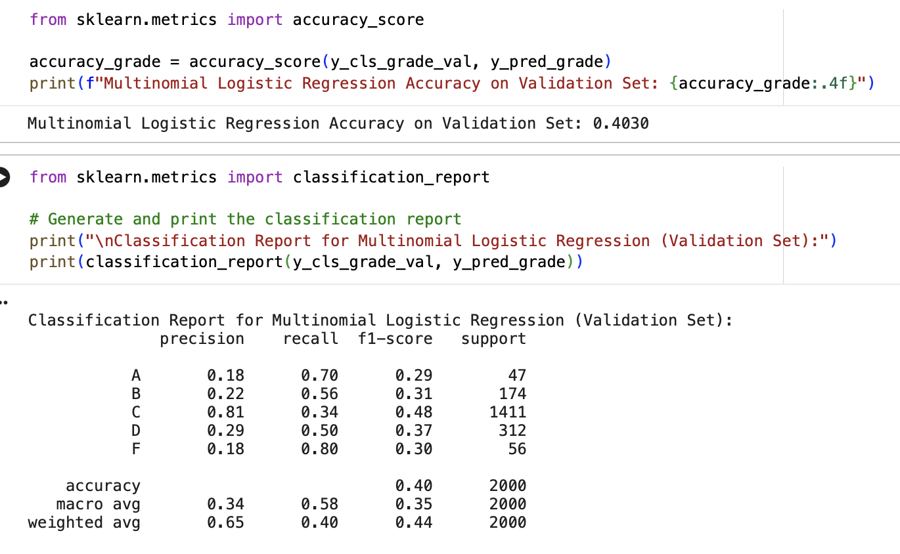
Multiclass Logistic Regression for final_grade

Slide 20
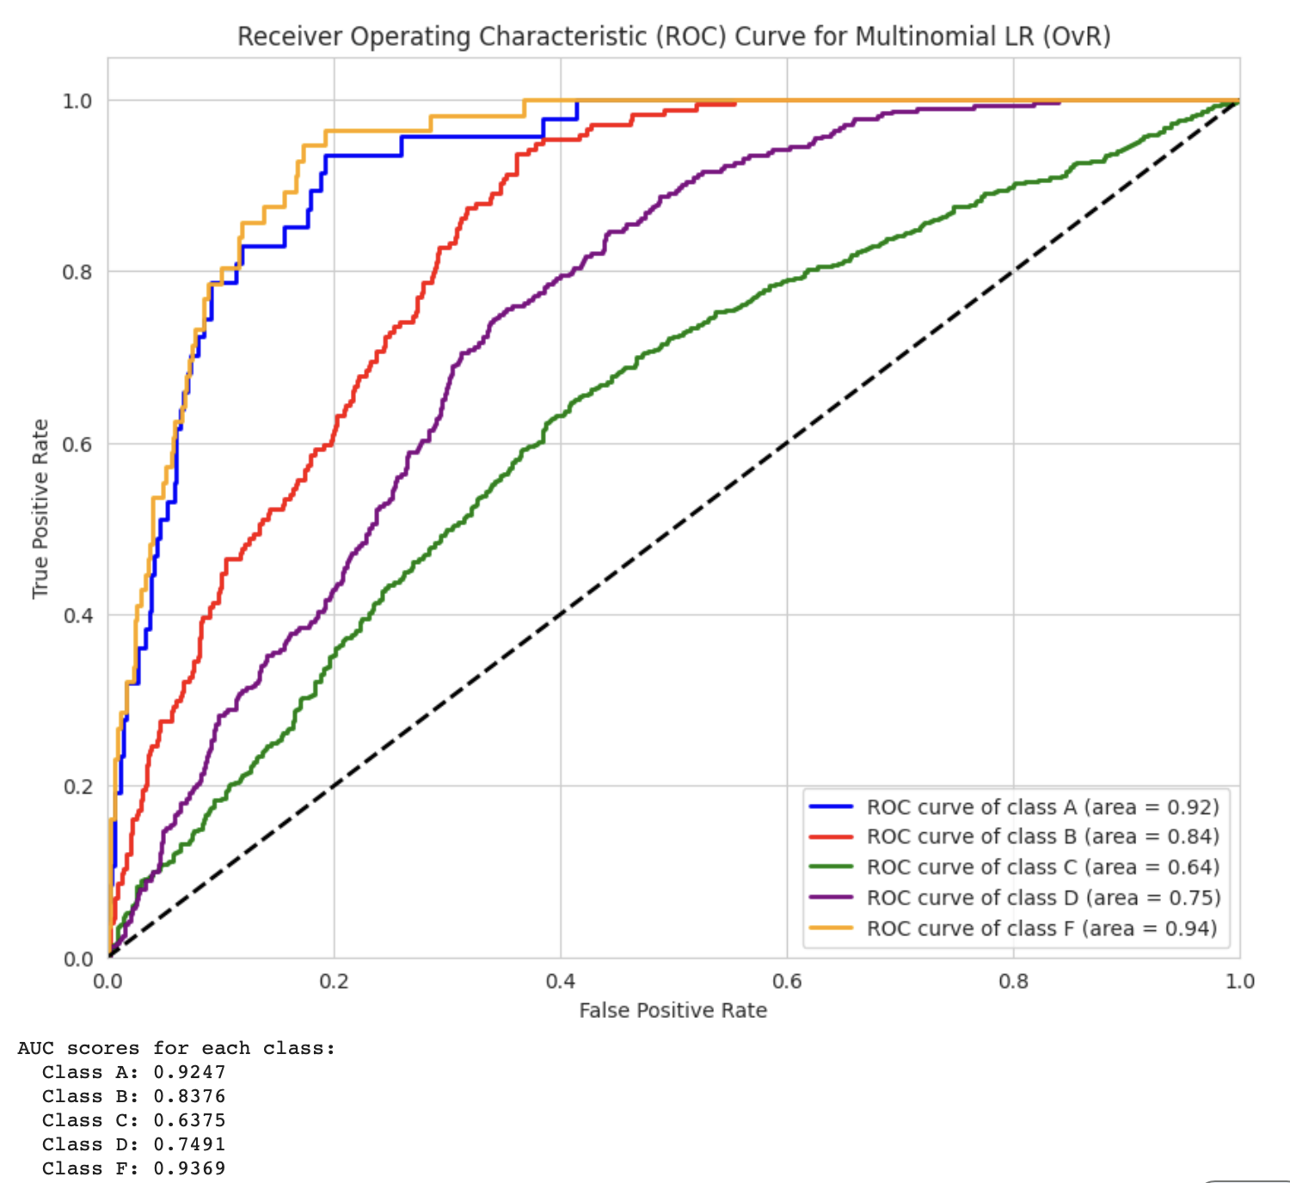
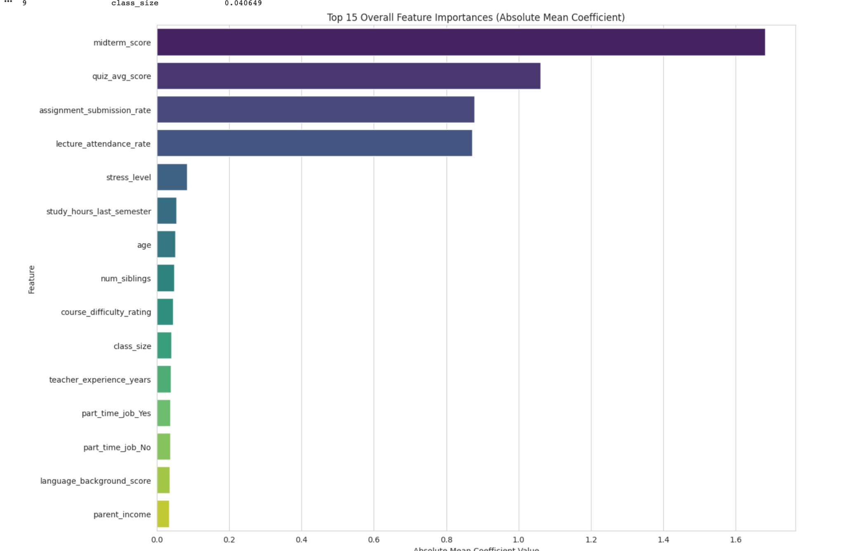
Multiclass Logistic Regression for final_grade

Slide 21
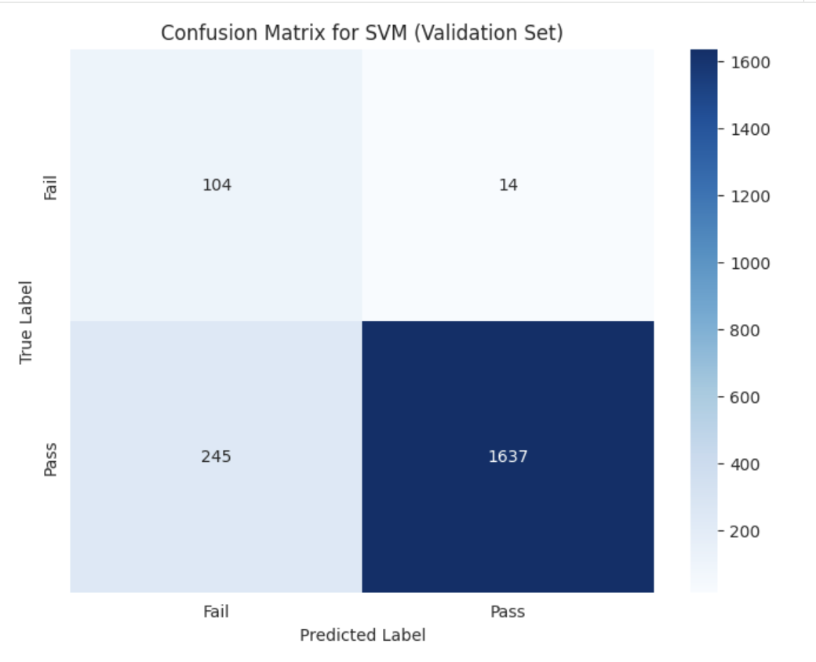
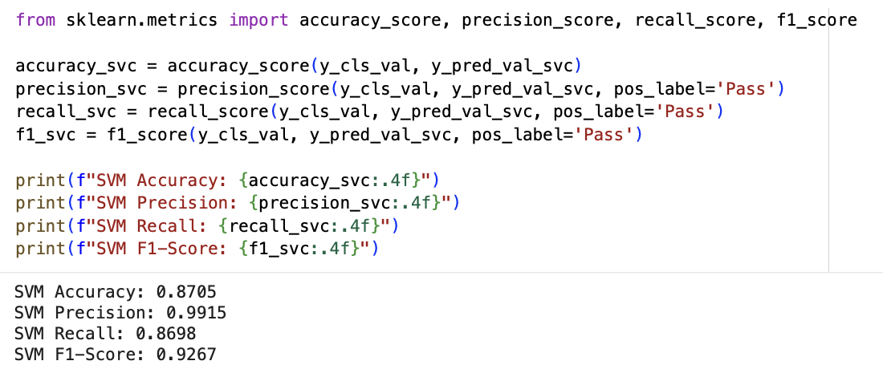
SVM for pass_fail

Slide 22
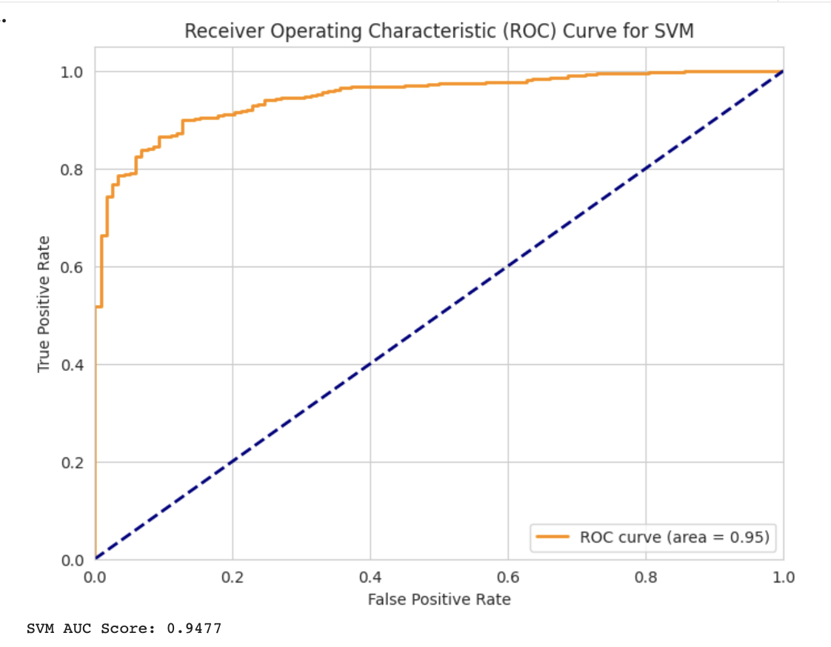
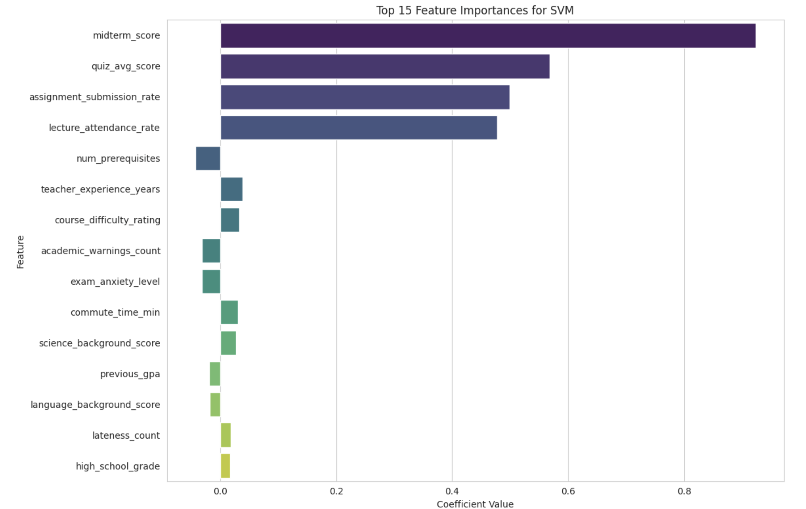
SVM for pass_fail

Slide 23
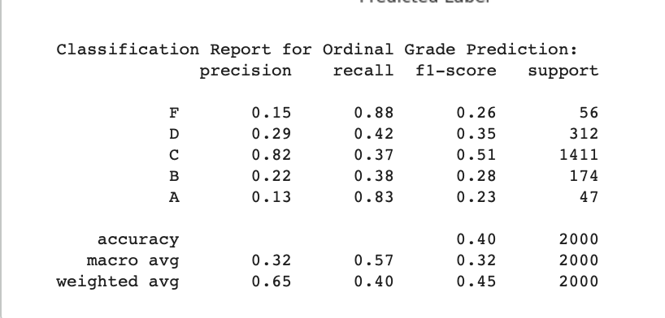
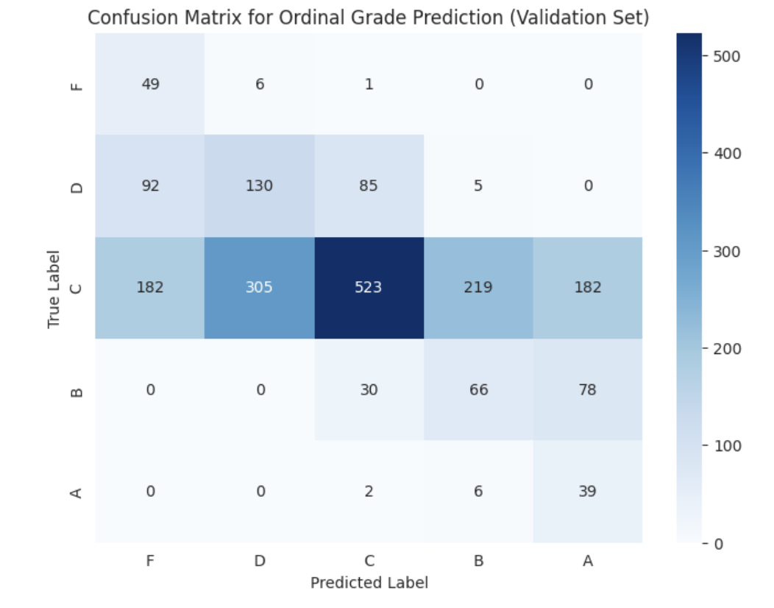
SVM for final_grade

Slide 24
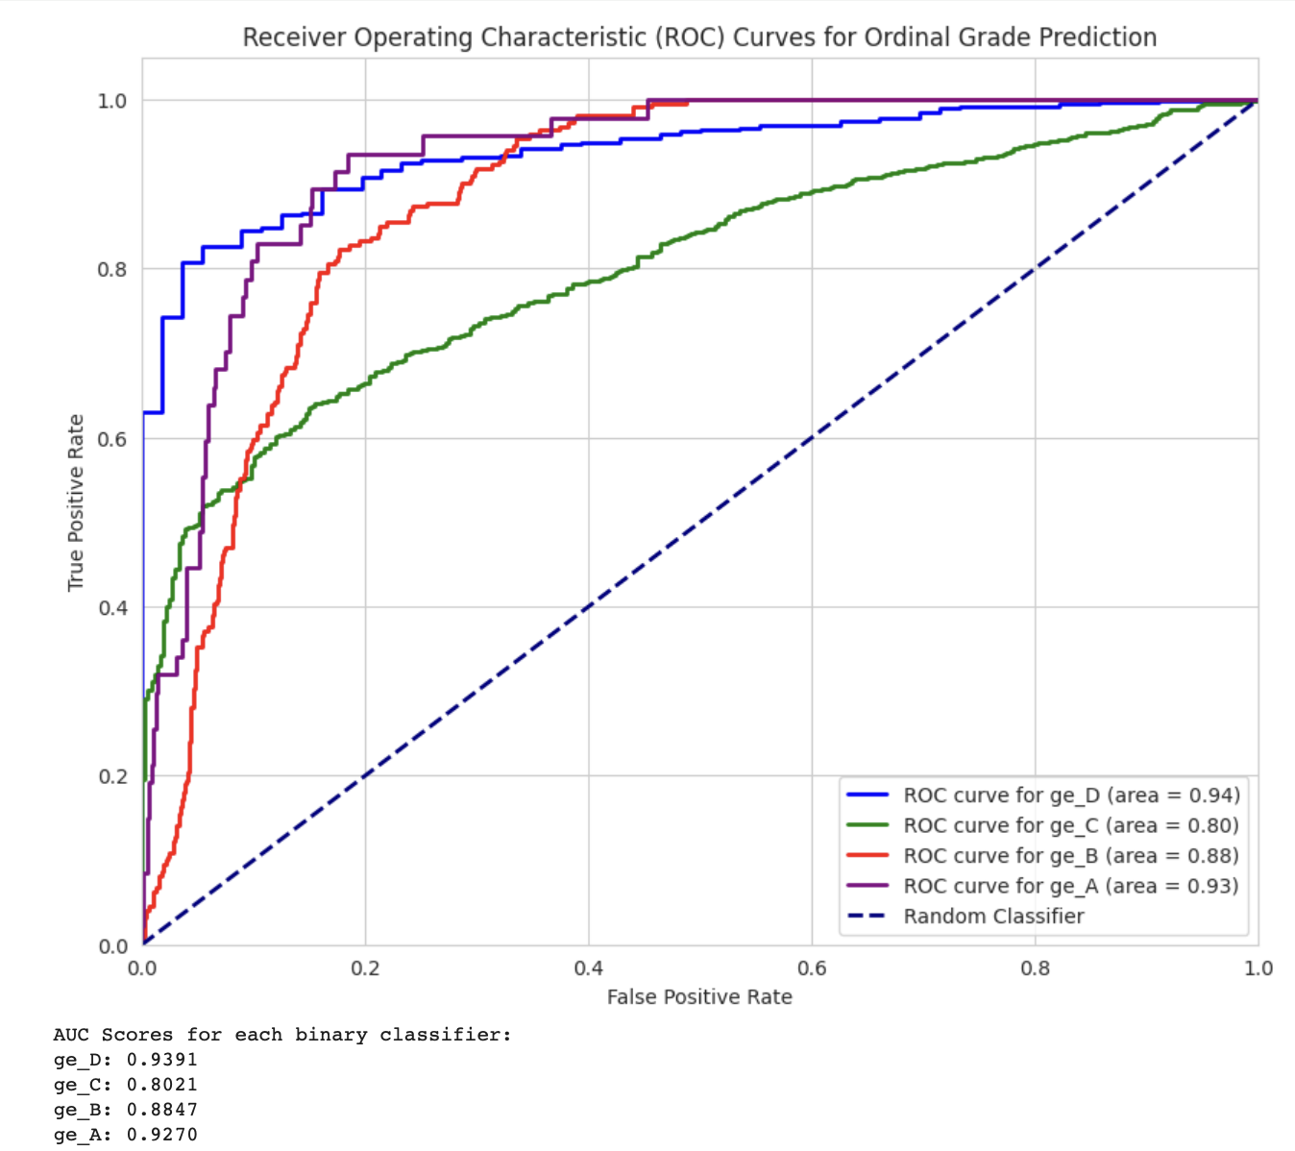
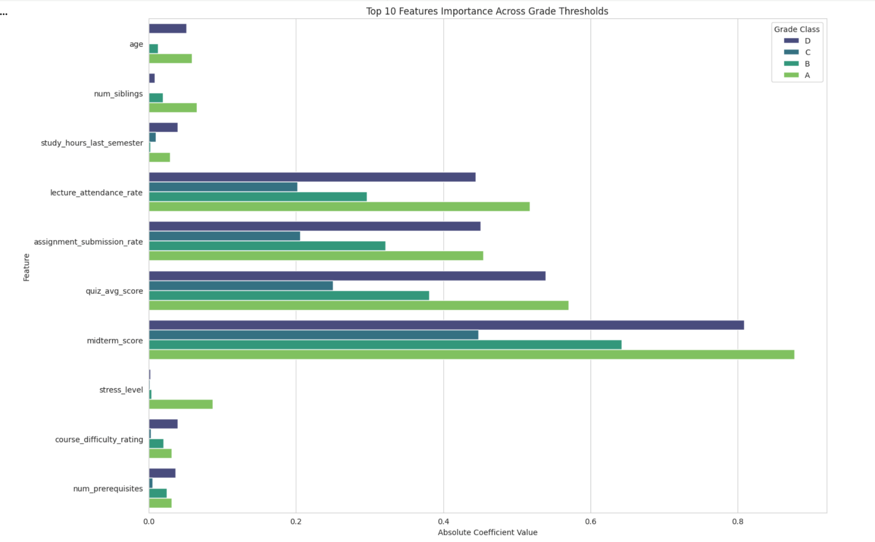
SVM for final_grade

Slide 25
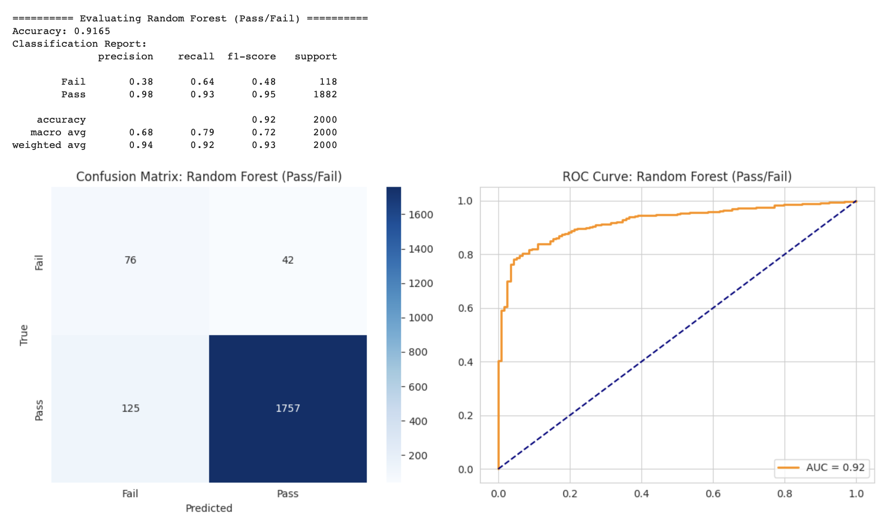
Random Forest for pass_fail

Slide 26
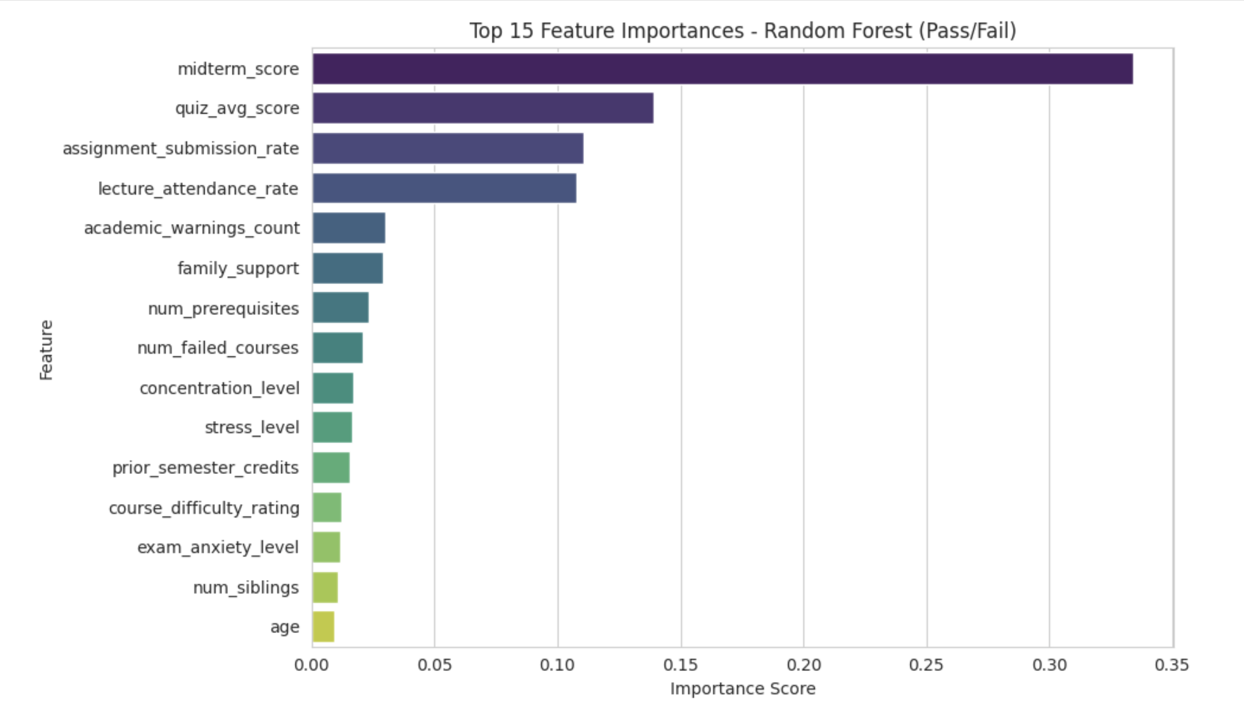
Random Forest for pass_fail

Slide 27
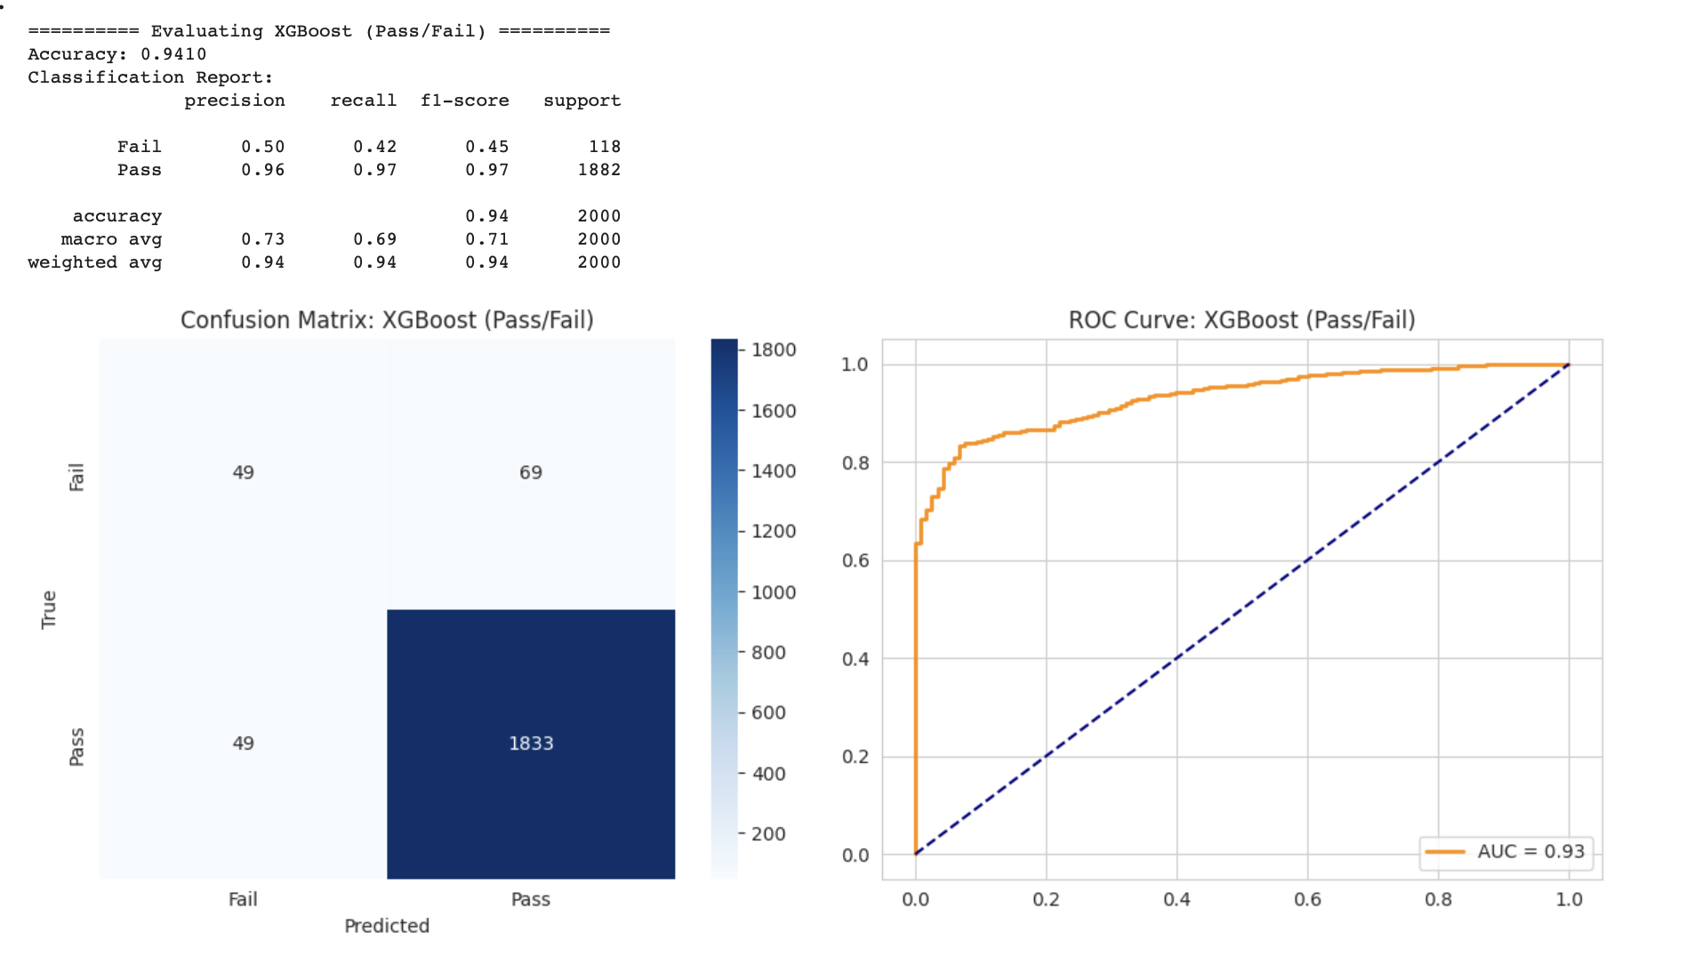
XGBoost for pass_fail

Slide 28
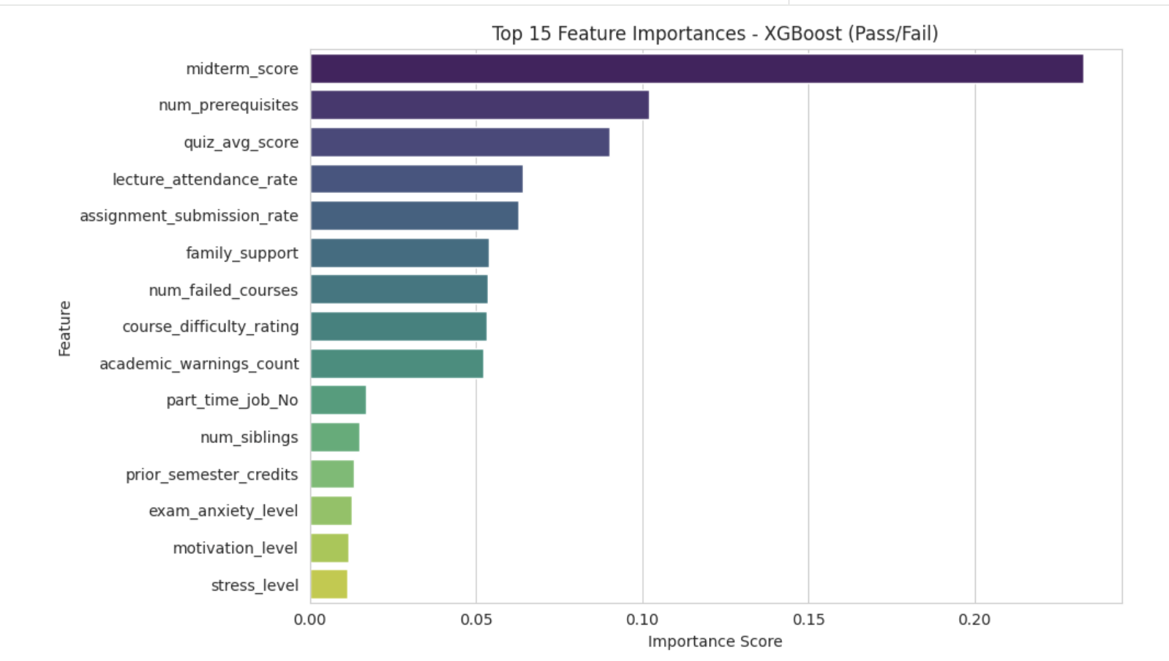
XGBoost for pass_fail

Slide 29


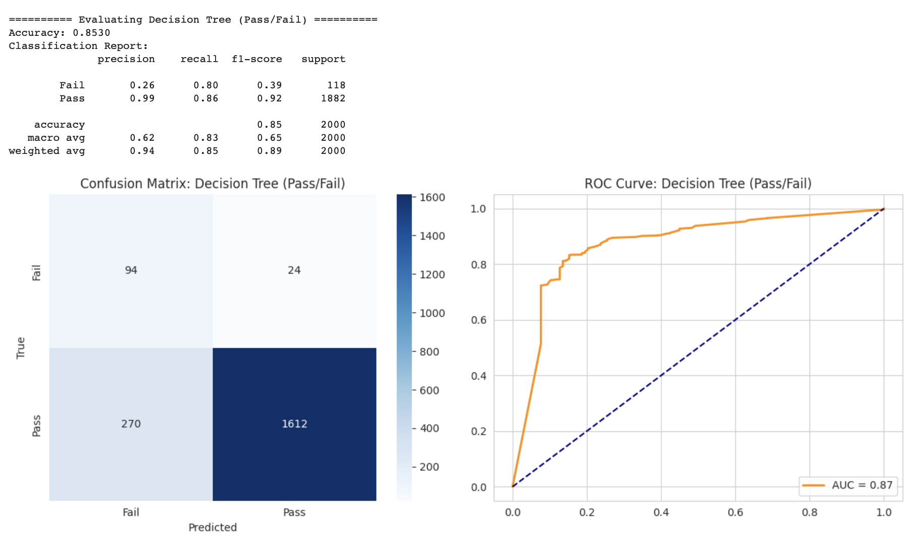
Decision Tree for pass_fail

Slide 30
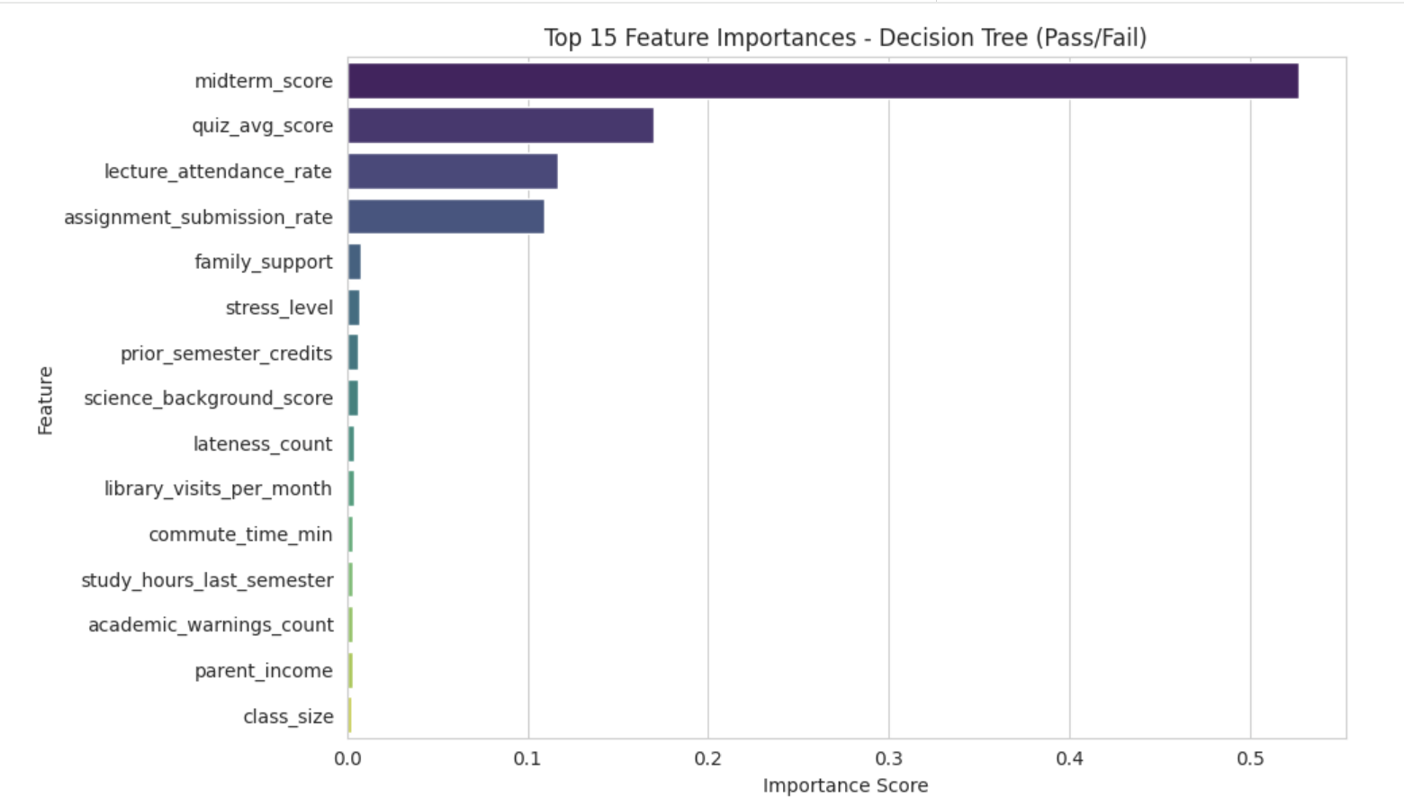
Decision Tree for pass_fail

Slide 31
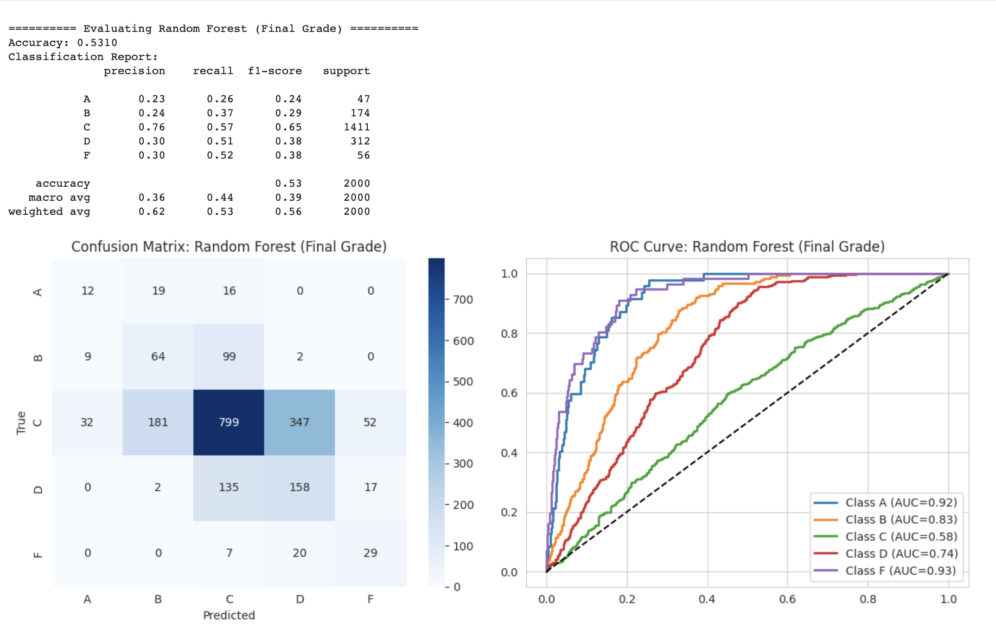
Random Forest for final_grade

Slide 32
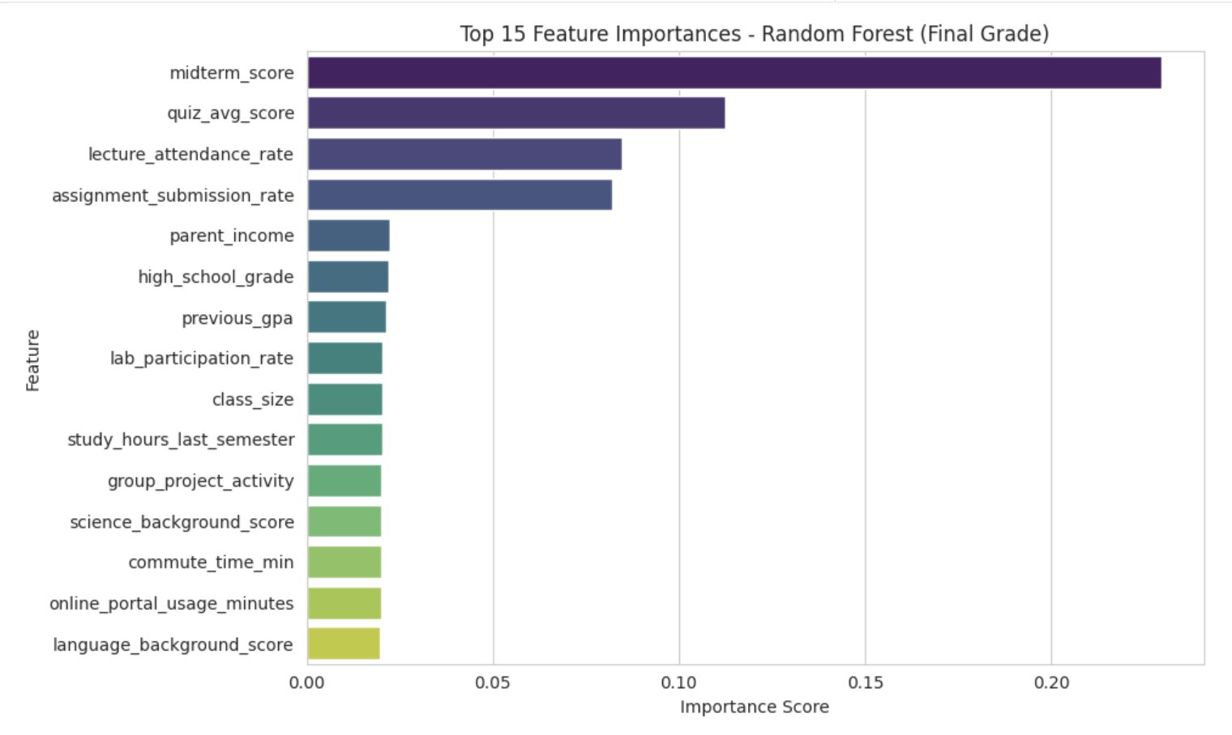
Random Forest for final_grade

Slide 33
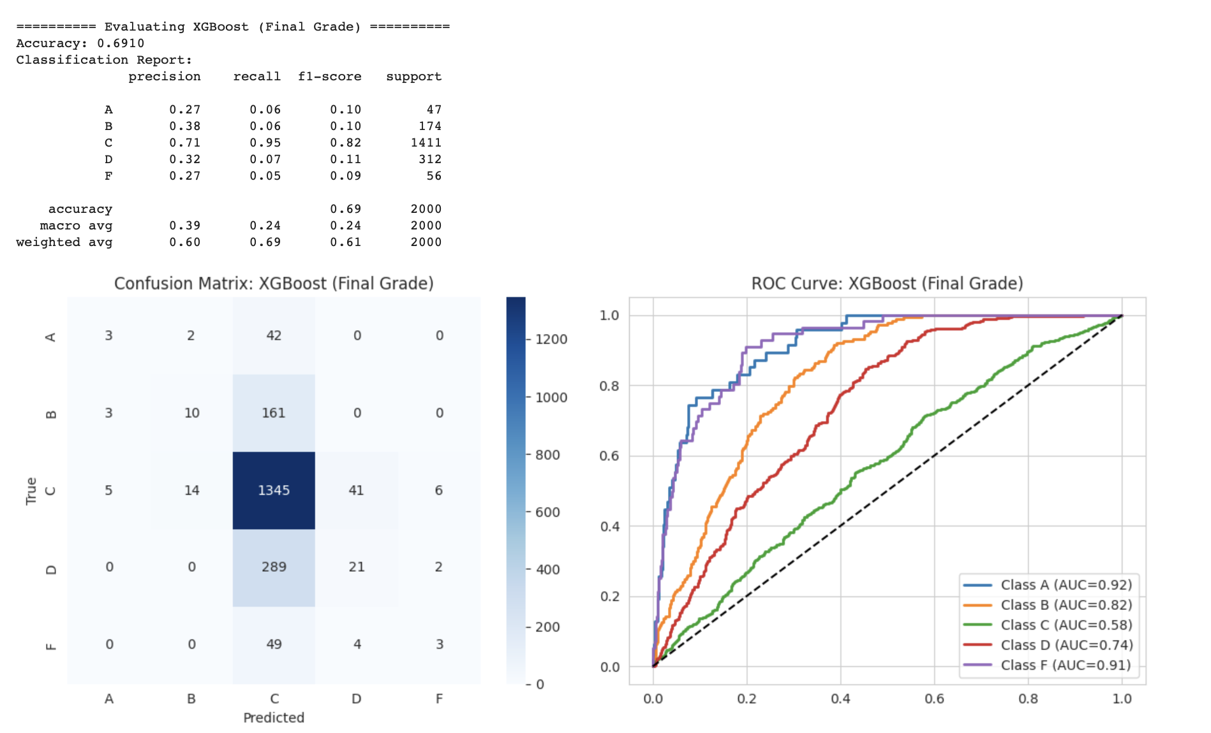
XGBoost for final_grade

Slide 34
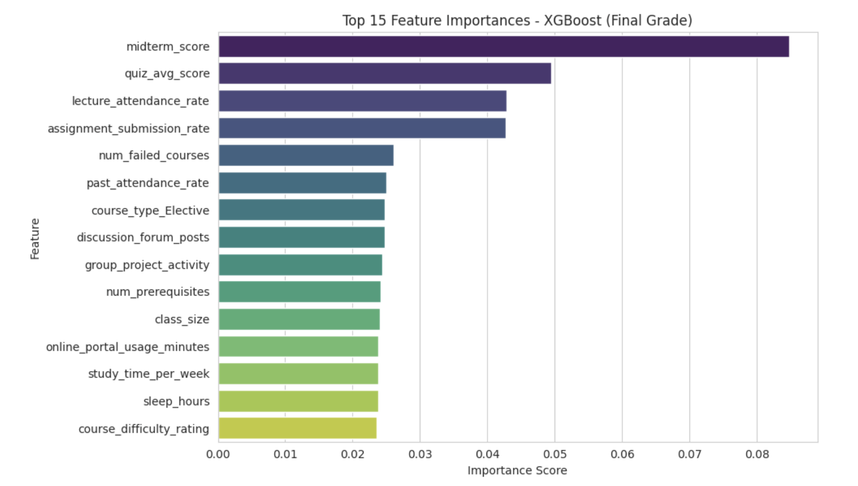
XGBoost for final_grade

Slide 35
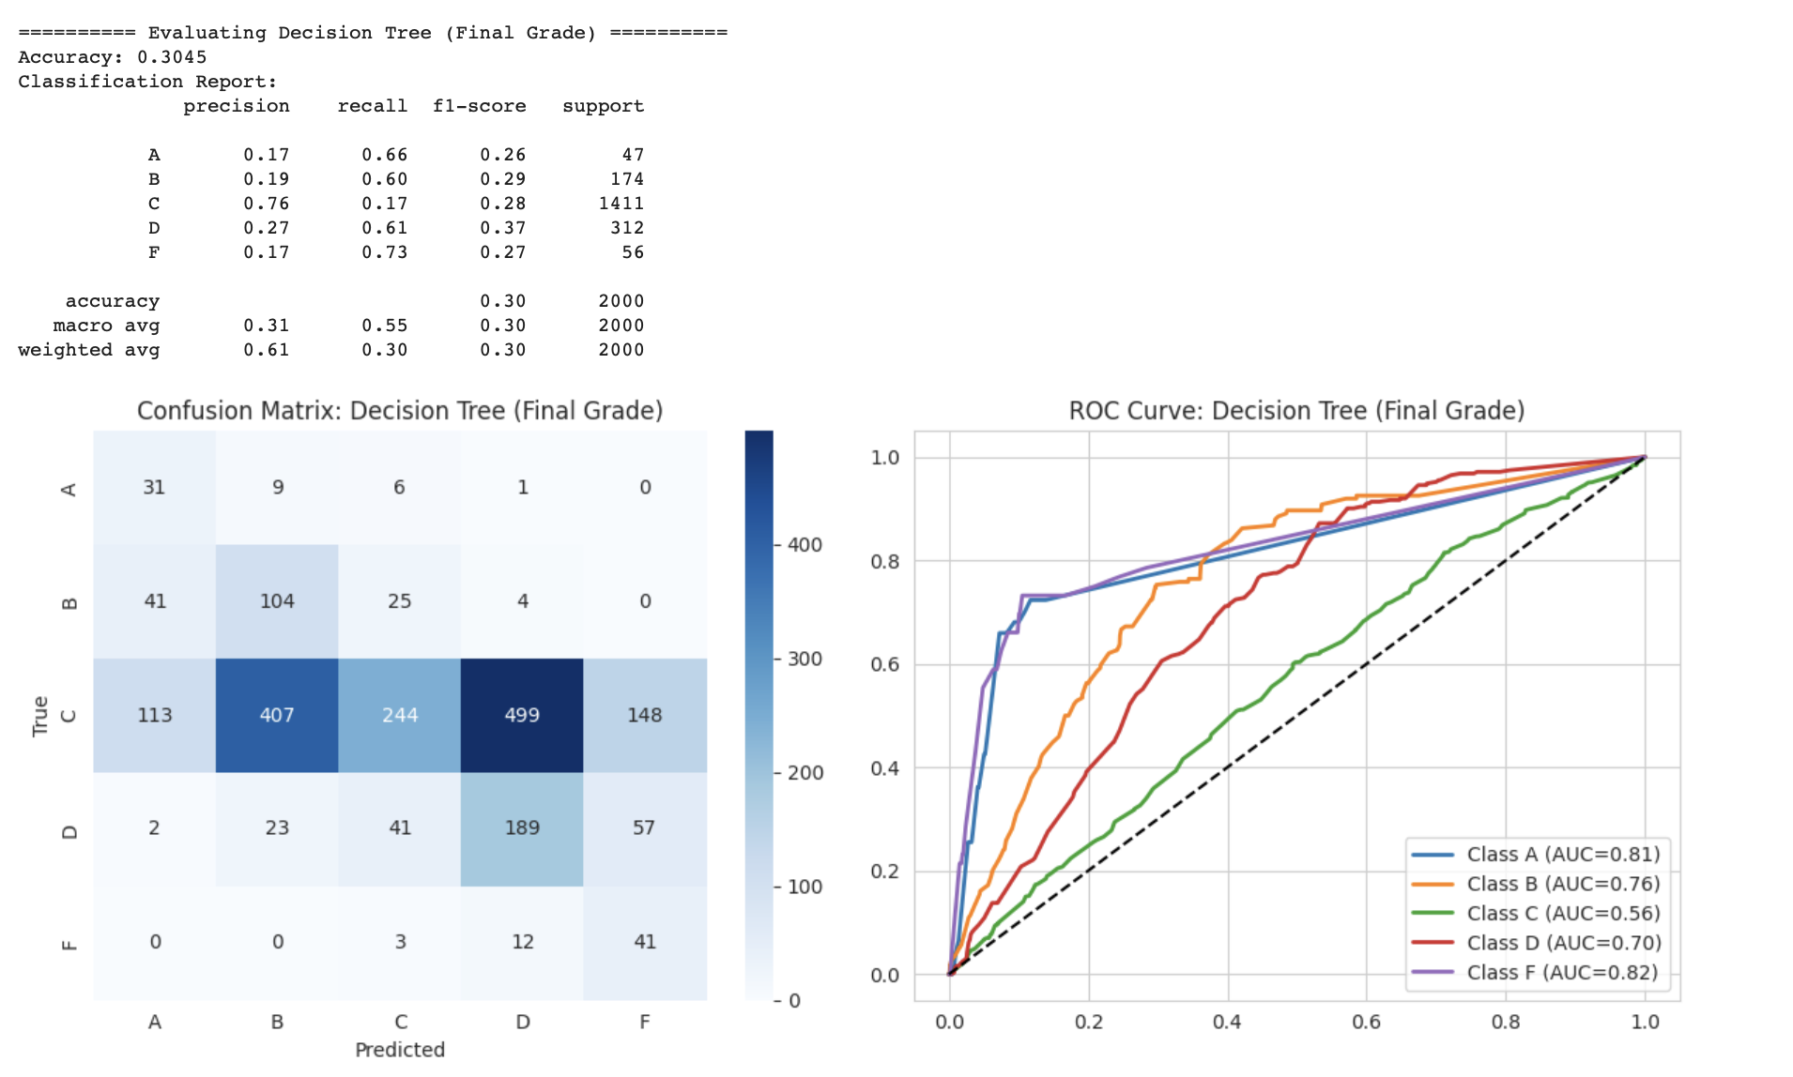
Decision tree for final_grade

Slide 36
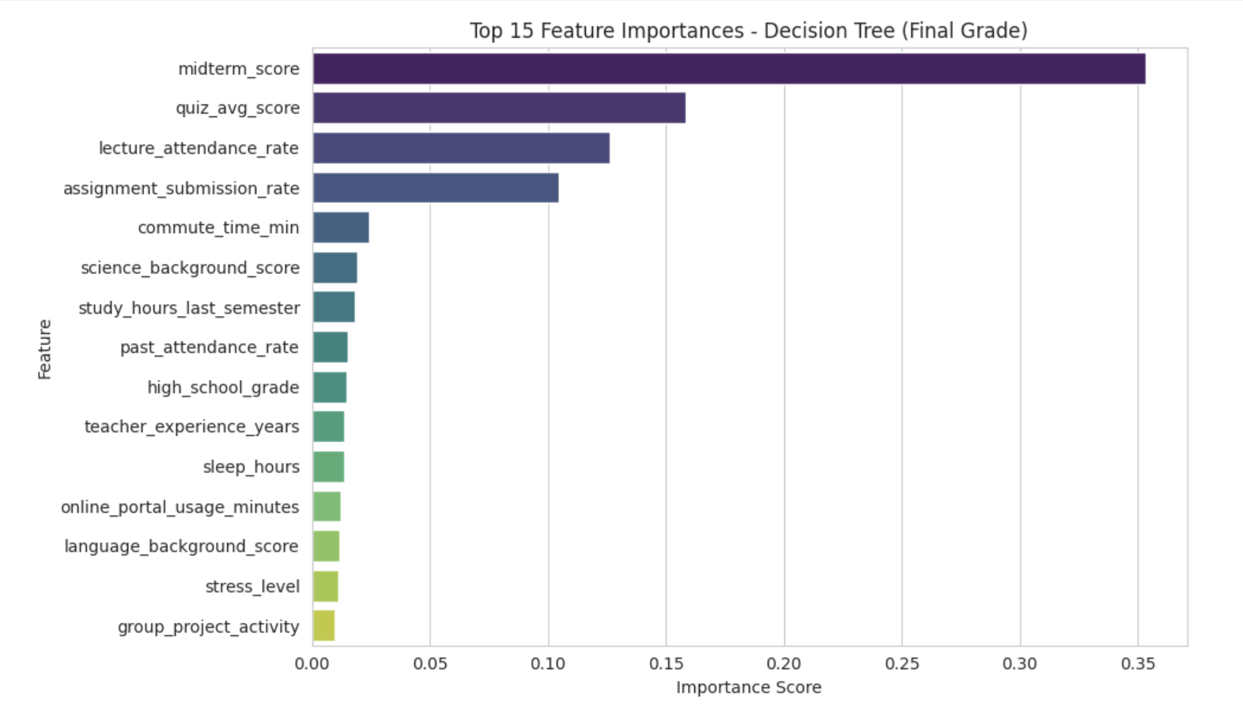
Decision tree for final_grade

Slide 37
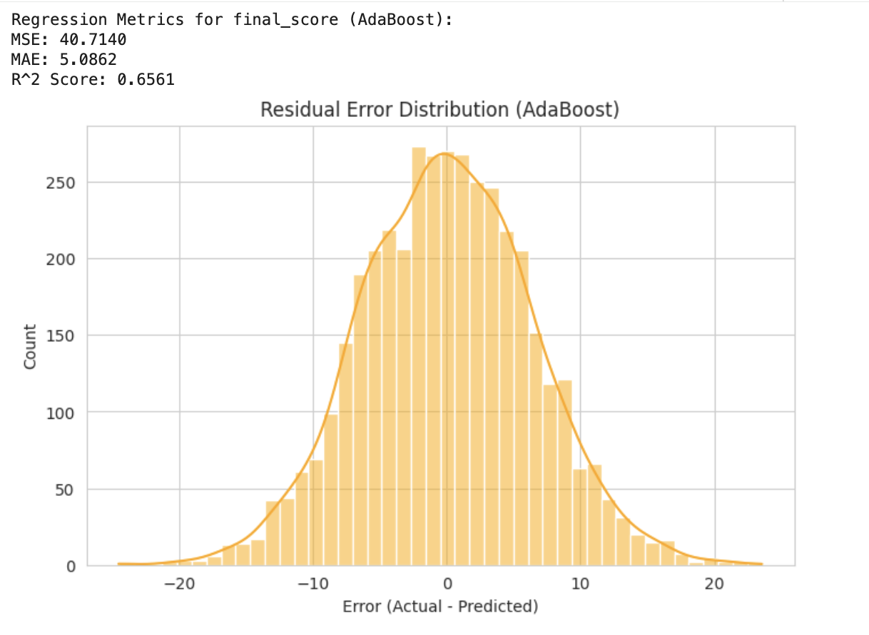
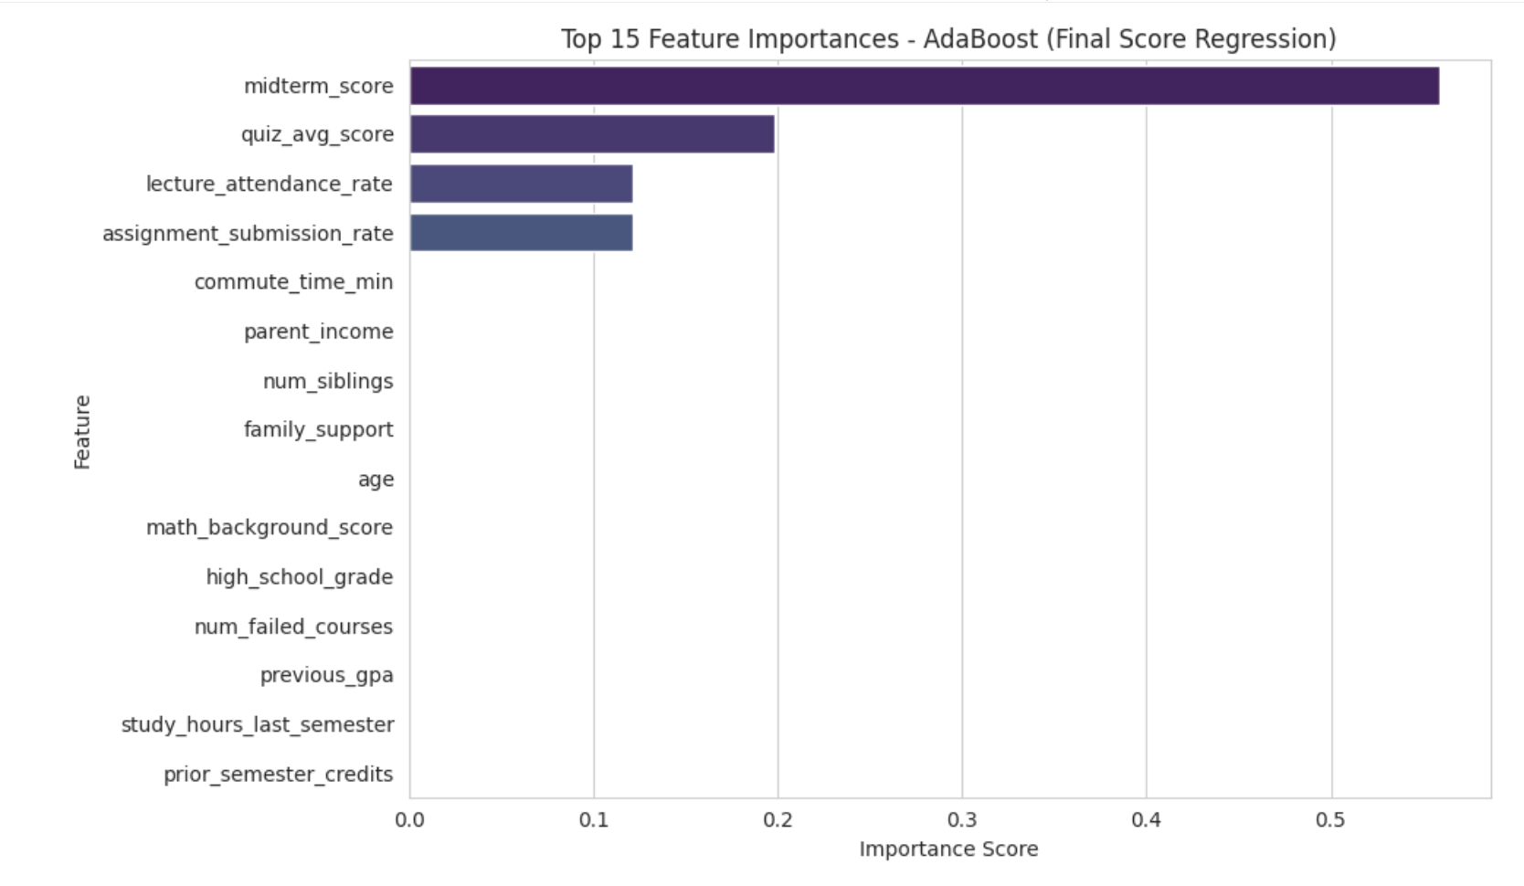
AdaBoost for final_score

Slide 38
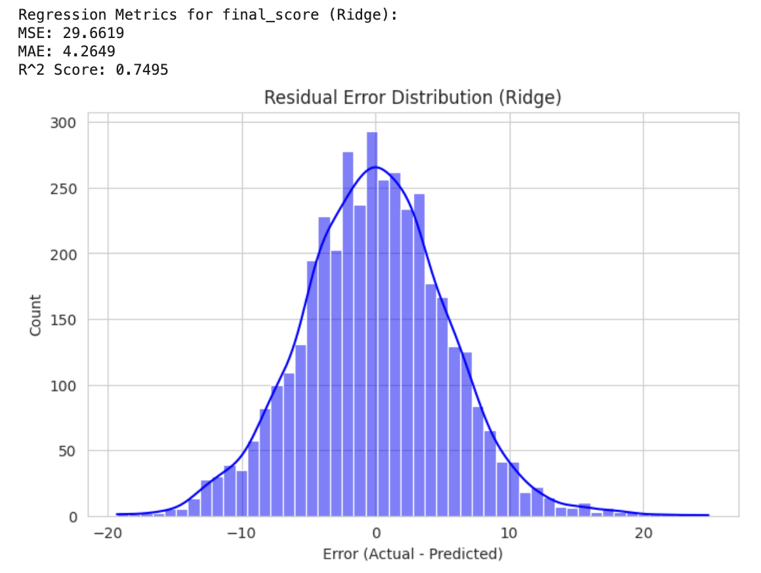
Ridge Regression for final_score

Slide 39
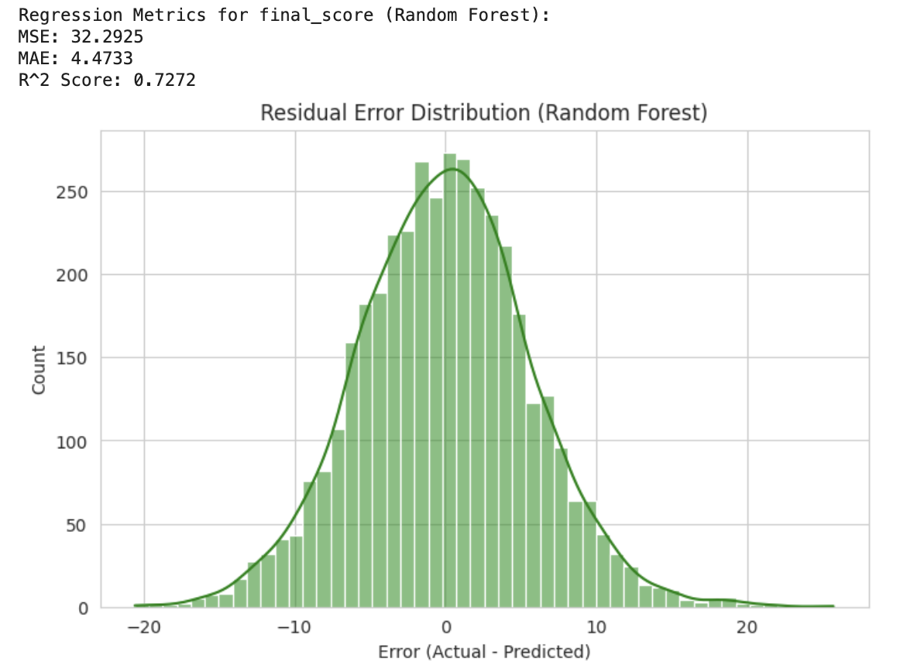
Random Forest for final_score

Slide 40
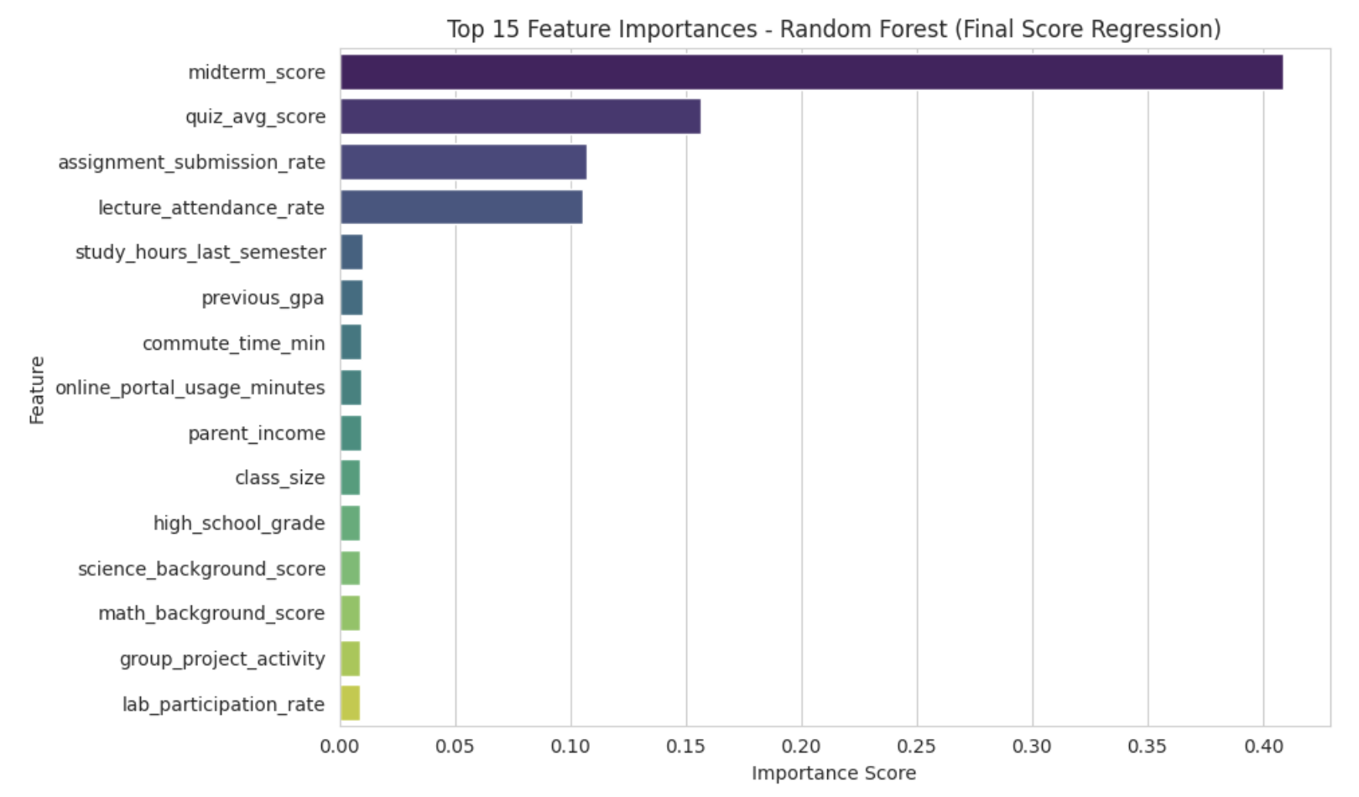
Random Forest for final_score

Slide 41
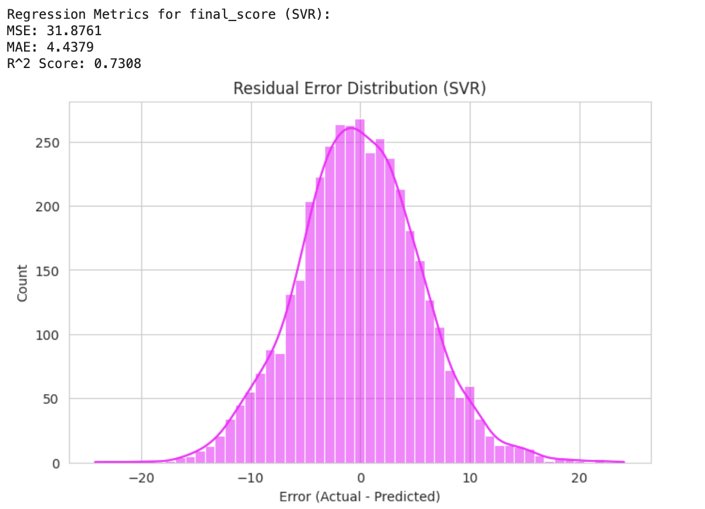
SVR for final_score

Slide 42


Model performance comparison table
Model | Accuracy | Precision | Recall | F1-Score
Binary Logistic Regression for pass_fail | 0.8725 | 0.9909 | 0.8725 | 0.9279
SVM for pass_fail | 0.8705 | 0.9915 | 0.8698 | 0.9267
Random Forest for pass_fail | 0.92 | 0.38 Fail | 0.64 Fail | 0.48 Fail
 |  | 0.98 Pass | 0.93 Pass | 0.95 Pass
Decision Tress for pass_fail | 0.85 | 0.26 Fail | 0.80 Fail | 0.39 Fail
 |  | 0.99 Pass | 0.86 Pass | 0.92 Pass
XGBoost (Gradient Boosting) | 0.94 | 0.50 Fail | 0.42 Fail | 0.45 Fail
 |  | 0.96 Pass | 0.97 Pass | 0.97 Pass

Slide 43




Model performance comparison table
Model | Accuracy
Binary Logistic Regression for final_grade | 0.40
SVM for final_grade | 0.40
Random Forest for final_grade | 0.53
Decision Tress for final_grade | 0.30
XGBoost (Gradient Boosting) | 0.69

Slide 44


Model Selection Outcome
Our comparative analysis revealed that XGBoost delivered the highest predictive performance. Outperforming all other models tested including SVM, Random Forest, and our linear baseline. XGBoost achieved better accuracy by effectively modeling complex, non-linear relationships within the student data. This result reveals the power of advanced ensemble methods in capturing the detailed factors that determine academic success.

Slide 45
Model performance comparison table
Model | MSE | MAE | R2 score
Ridge | 29.66 | 4.26 | 0.75
XGBoost | 30.95 | 4.37 | 0.74
SVR | 31.88 | 4.44 | 0.73
Random Forest | 32.29 | 4.47 | 0.73
AdaBoost | 40.71 | 5.09 | 0.67

Slide 46
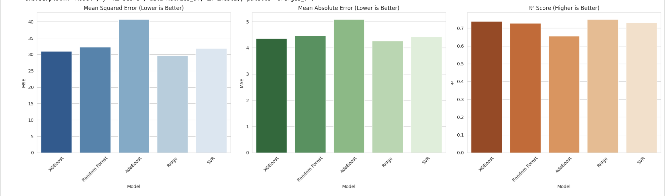
Model performance comparison

Slide 47
Model Selection Outcome
The Ridge Regression model demonstrated the strongest performance across all key metrics, achieving the lowest Mean Squared Error and Mean Absolute Error, as well as the highest R² score. This indicates that Ridge Regression provided the most accurate and stable predictions of student scores, explaining approximately 75% of the variance in the data.

Slide 48

THANK YOU!

